Slide 1
Monument Town Council Workshop
April 3, 2023

Slide 2
Presentation Overview
Water Rights Portfolio
Reservoir Storage
Environmental NEPA Processes
County 1041 Permits
Water Right Change Cases Pending and Decreed
Overview of Northern Delivery System
Convey Treat and Deliver Contract Colorado Springs Utilities

Slide 3
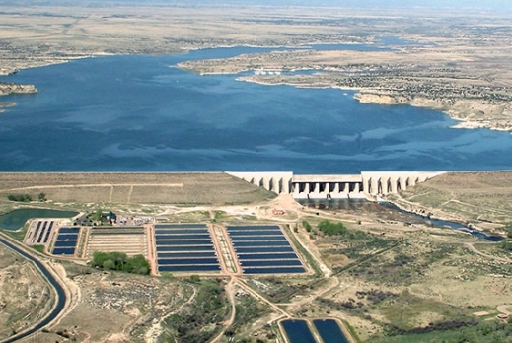
Request for 1041 Permit: Pueblo Reservoir 999 ac-ft Excess Storage and Conveyance

Slide 4
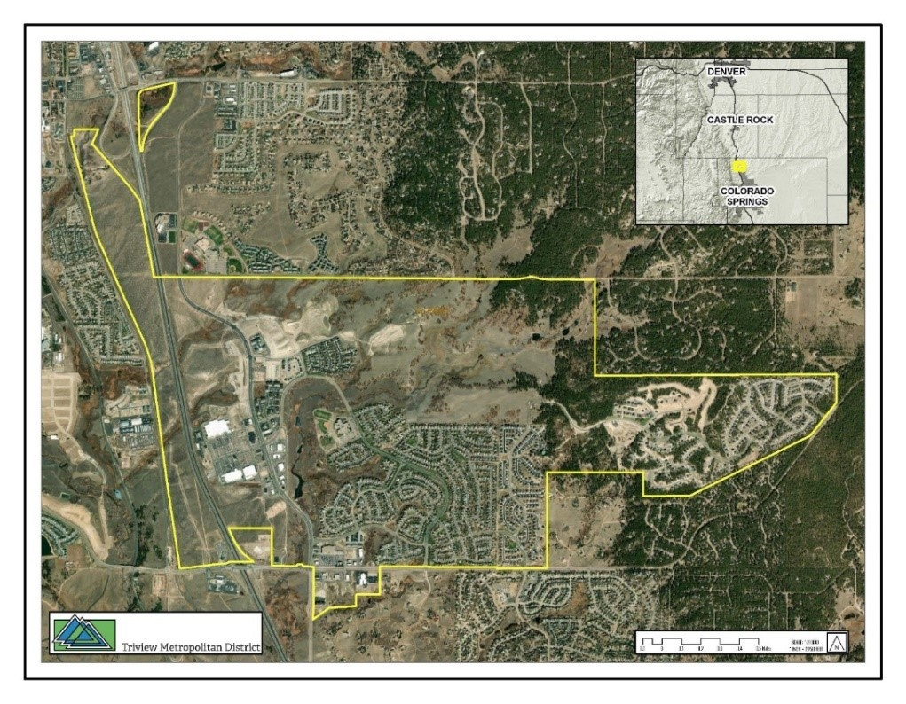
What is Triview Metropolitan District?
Title 32 metropolitan district, public entity with elected Board
Owns and maintains facilities that provide water, wastewater, and stormwater services, Parks and Open Space & Road Maintenance to a 2,590-acre service area within the Town of Monument, Colorado.
~ 2,150 homes and 75 commercial customers.
Triview’s service area is located entirely within the Arkansas River Basin.
Triview Metropolitan District Boundaries Map (Triview, 2018)

Slide 5
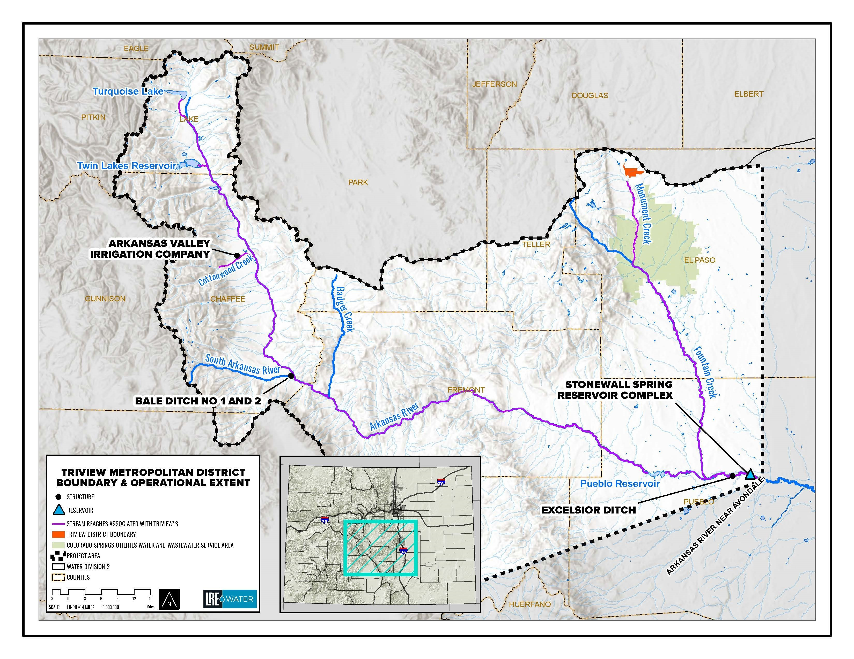
Water Rights Purpose: Sustainability
Current water supply from 9 nonrenewable wells within the Denver Basin
Acquiring renewable water sources for long-term solution and the development of a Conjunctive Use Project
FMIC 740 AF
Excelsior Ditch Co 568 AF
AVIC 550 AF
Bale Ditch 100 AF
Total Purchase Water Rights 1,958 AF
Reusable Return Flows +/- 1,000 AF
Additional storage is needed to manage the variability and to recapture the reusable return flows

Slide 6
Storage Rights Purpose: Sustainability
US Bureau of Reclamation “Excess Capacity Contract”
Allows storage up to 999 AF in Pueblo Reservoir “if and when space” available for municipal purposes.
Allows Use of North Outlet Works at Pueblo Reservoir which is connected to Springs Utilities Southern Delivery System
Executed by USBR Dec. 29, 2021.
Storage
Big Johnson Reservoir 912 AF
Stonewall Springs Reservoir Complex (South Reservoir) 1,850 AF
Reusable effluent accruing to Fountain Creek derived from all of the above sources as well as Denver Basin groundwater supplies
Direct flow or exchange water delivered to Colorado Springs Utilities
(CS-U) Southern Delivery system (SDS) through the North Outlet Works (NOW)

Slide 7
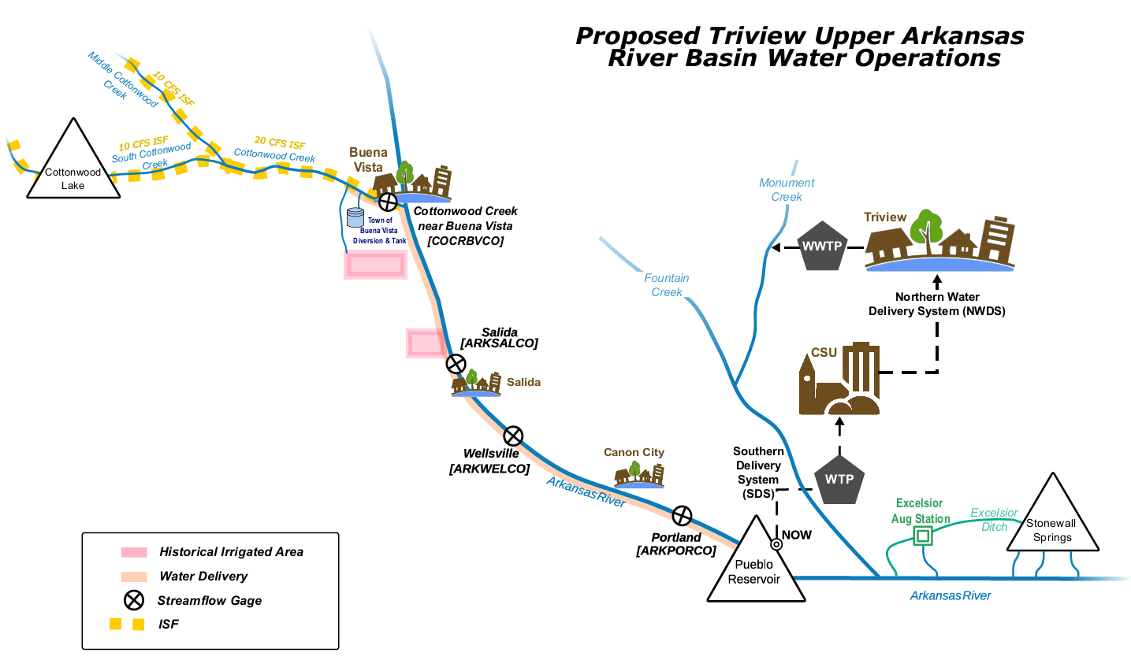

Slide 8
Triview 1041 Operations
Triview’s CU credits from the AVIC and Bale ditches will flow down the Arkansas River into Pueblo Reservoir, where the water will either be conveyed directly to Triview’s service area via the SDS or stored using the Contract.
Triview’s reusable effluent in Fountain Creek, as well as Triview’s FMIC shares, will flow to the Fountain Creek confluence with the Arkansas River. These flows will be exchanged up the Arkansas River into Pueblo Reservoir when exchange opportunity exists and in full compliance with the City of Pueblo’s Flow Management Program for the RICD.
Water delivered through SDS to Colorado Springs and ultimately to TMD Service Area through the Northern Delivery System.

Slide 9
Partnership to Avoid Construction
No new diversion or delivery facilities are required in Pueblo County
Store excess capacity account in Pueblo Reservoir
Raw water conveyed through SDS infrastructure
Contract with CS-U has been approved by City of Colorado Springs City Council March 28, 2023

Slide 10
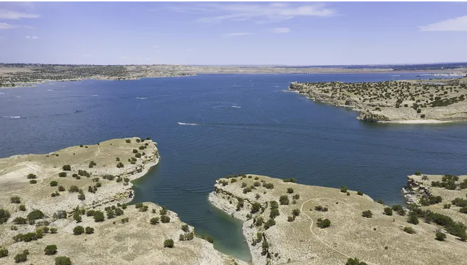
Pueblo Reservoir – No Impact
Surface area of approximately 4,646 acres
Storing Triview’s maximum 999 AF would cause the Reservoir to rise less than 4.2 inches or 0.35%
Temporary excess capacity storage
No groundwater storage or impacts
No noticeable impact to the reservoir water level, recreation, the swim beach or boat ramps
Photo credit: Pueblo Chieftain

Slide 11
Permitting Change Cases Contracts
US Bureau of Reclamation Long-term Excess Storage Capacity Contract Issued December 29, 2021
Water Court change cases include:
FMIC Augmentation to Municipal use,
Excelsior Augmentation to Municipal use,
AVIC and Bale Agricultural to Municipal use
Colorado Springs Utilities Contract to utilize the SDS Convey, Treat, and Deliver Approved By City Council March 28, 2023
State and Division Engineer’s Office. Oversite of all operations.
Separate 1041 application for SSRC Operations submitted to Pueblo County July 22, 2022. In Progress.
NEPA Process as directed by Bureau of Reclamation resulting in Finding of No Significant Impacts October 27, 2021

Slide 12
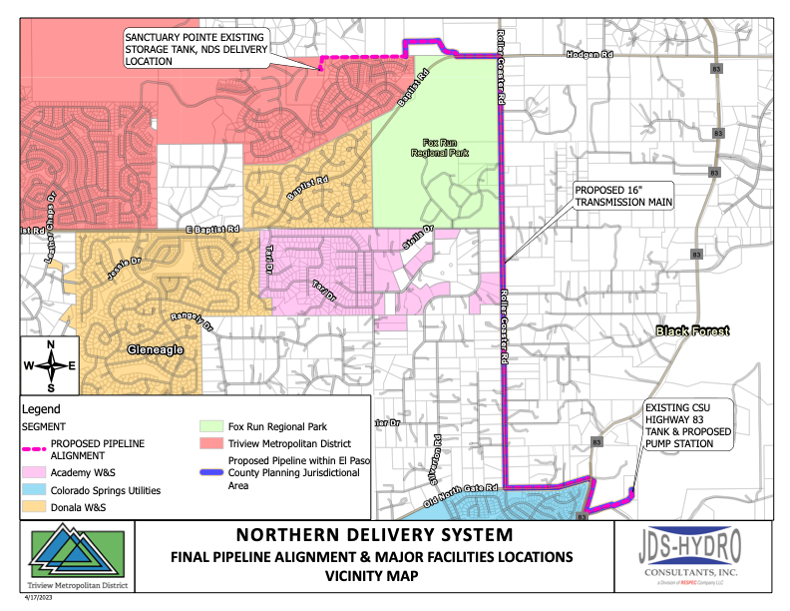

Slide 13
Northern Delivery Capacity as Designed
16” Pipeline
Designed Flow Rate 4.0 MGD
Triview 2.475 MGD
Forest Lakes 0.220 MGD
Donala 0.542 MGD
Monument 0.750 MGD
Total 3.987 MGD

Slide 14
Status Of Northern Delivery System
Convey Treat and Deliver Contract Approved by Colorado Springs City Council March 28, 2023
El Paso County 1041 permit Approved March 30, 2023
Pipeline Plans 100% Complete
Pump Station Plans 95% Complete
Construction Contract Awarded to Kiewit Infrastructure March 23, 2023. Total Project Cost Approximately $21,600,000
Materials Pre Ordered Including Pipe, Valves, Bends,
Pump Station Electrical Gear & Transformers Pre Ordered
Construction Notice to Proceed issued April 3, 2023
Estimated Completion Date August 2024

Slide 15
Colorado Springs Utilities Convey Treat and Deliver Contract
Jenny Bishop:

Slide 16
Moving to Renewable Water Sources
Summary of Triview’s Renewable Water:
Provide water storage and conveyance capacity to increase water management flexibility within Triview’s water supply portfolio and service area
Reduce Triview’s dependency on nonrenewable groundwater
Goal: Supply Future Water Demands with 80% -90% Renewable Water
Meet Peak Demands with Denver Basin Wells
Facilitate conversion to renewable surface water
Maximize the use of existing infrastructure, including SDS, to serve Triview’s municipal and industrial water supply demands where feasible.
Triview anticipates that it will be substantially built out by 2030.
Future Build Out Demand 2,200 Acre Feet
The Project will only replace currently utilized non-renewable Denver Basin Groundwater with renewable surface water supplies.
Opportunity to Partner does exist

Slide 17
Discussion/Questions

